Slide 1
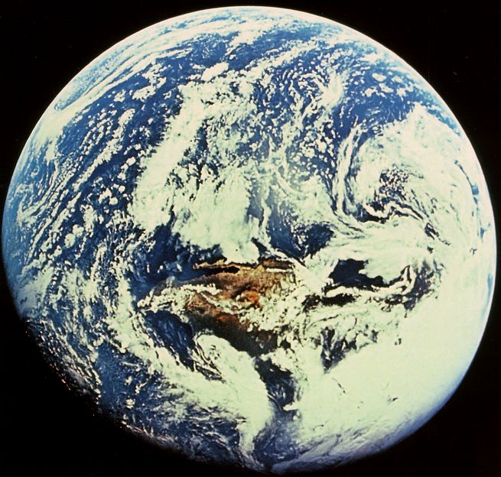

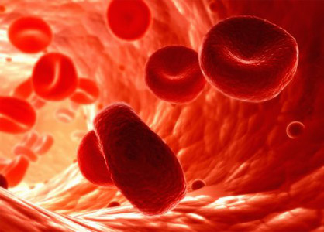
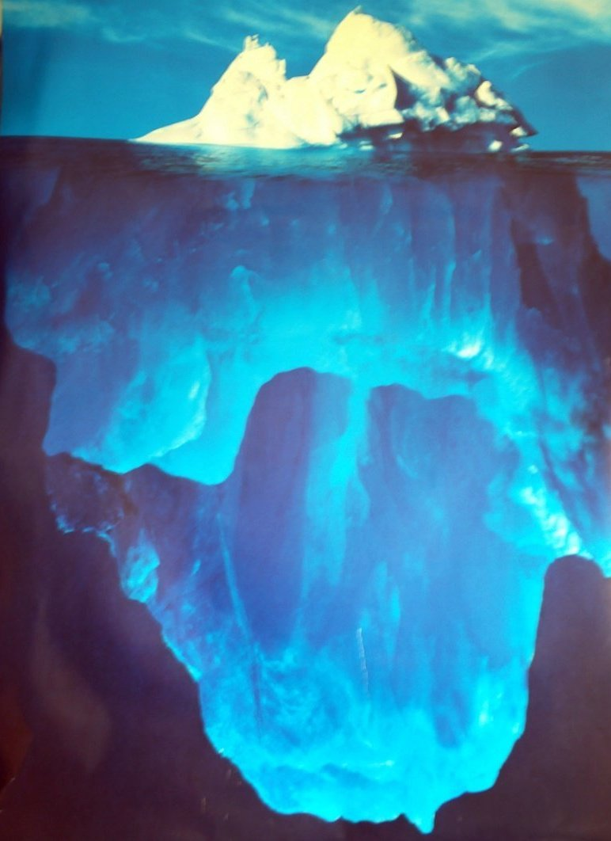
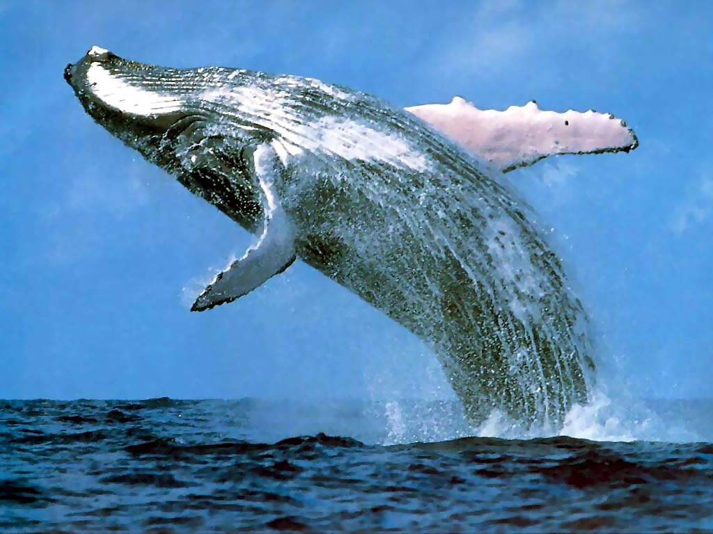
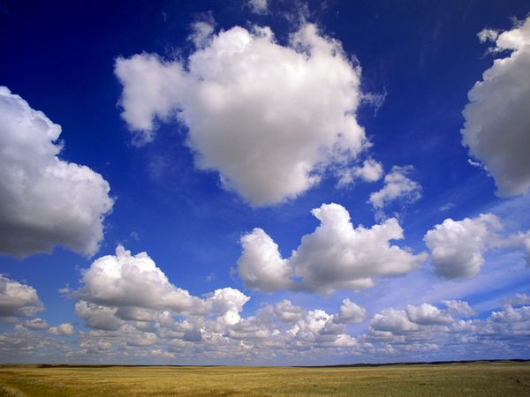
DFT problems with water?
QMC to the rescue!
Mike Gillan
London Centre for Nanotechnology, UCL and Thomas Young Centre
Water is very important….
…but it is very difficult to get its energetics right

Slide 2
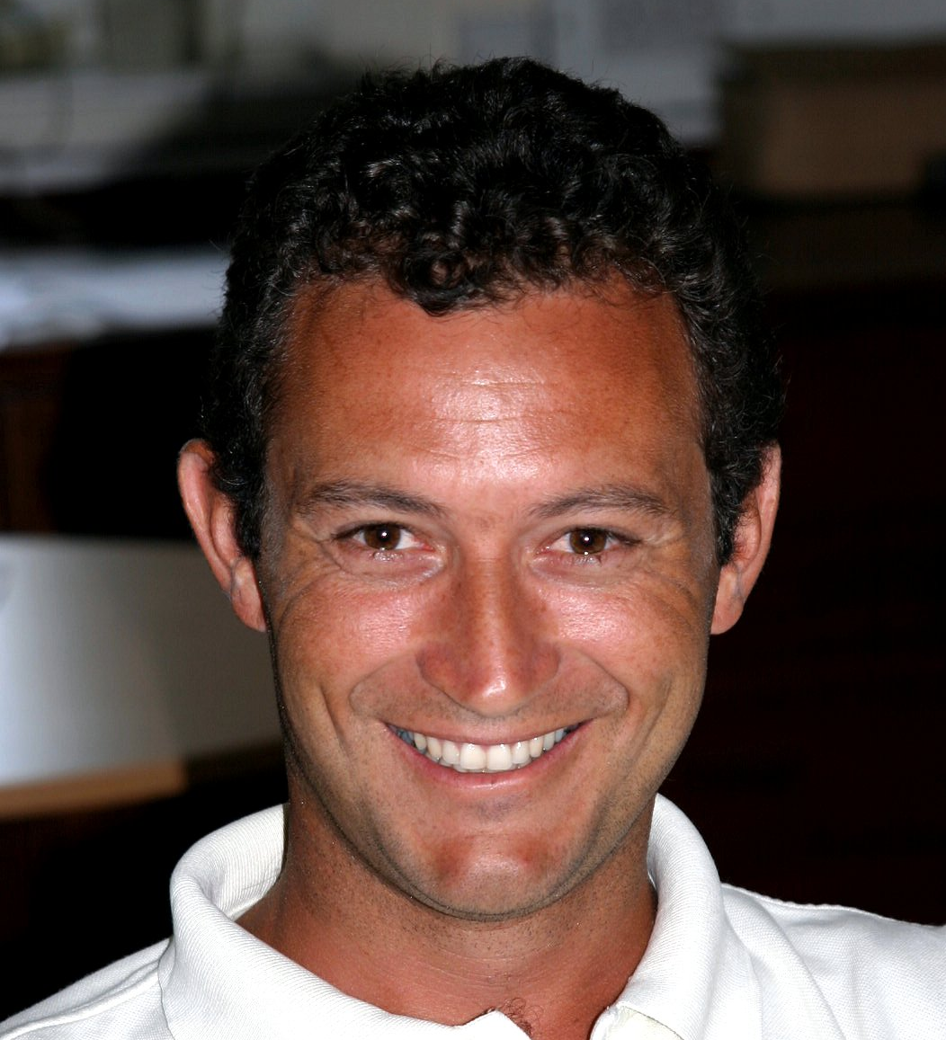





The people who are doing the real work…
Dario Alfè (UCL)
Gábor Csányi (Cambridge)
Albert Bartók-Pártay (Cambridge)
Fred Manby (Bristol)
Mike Towler (UCL &Cambridge)
Angelos Michaelides (UCL)

Slide 3

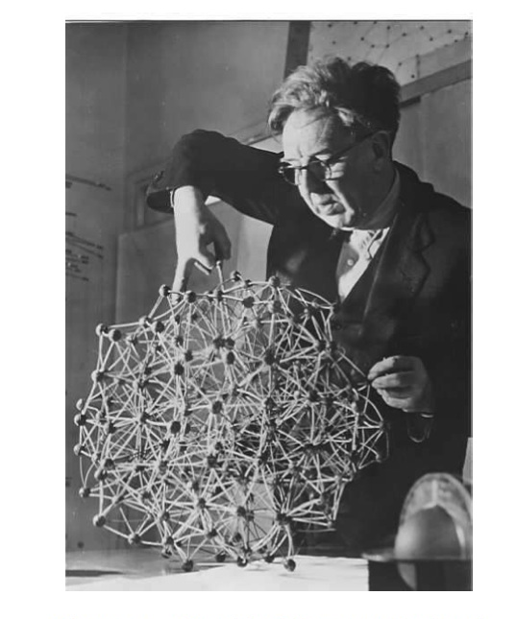
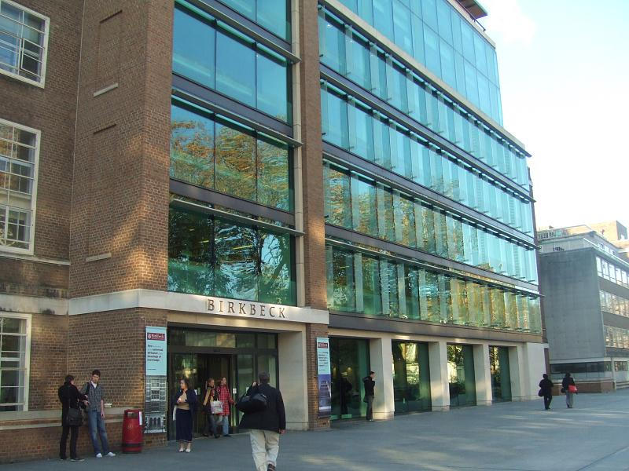
A bit of history…
J. D. Bernal and R. H. Fowler, Theory of water and ionic solutions, J. Chem. Phys., 1, 515 (1933)
University College London, founded 1826
Birkbeck College, founded 1823
J. D. Bernal makes a model of water

Slide 4
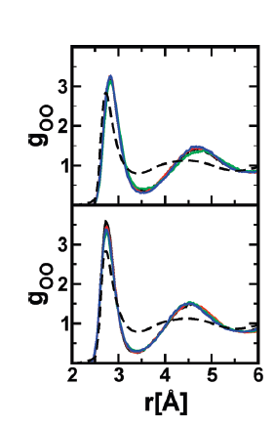
Water models through the ages…
Classical (rigid, unpolarisable): Bernal-Fowler, SPC, TIPnP, etc: 1933 onwards…
Classical (flexible, polarisable): Kollman, Dang-Chang, Ponder, Xantheas: AMOEBA, TTMn-F: 1990 onwards…
Ab initio-based: Clementi, Jordan, Szalewicz...: 1976 onwards…
DFT: Parrinello, Car, Sprik, Tuckerman, Galli and many others:1992 onwards…
Quantum nuclear corrections with path integrals: Manolopoulos, Xantheas, Car..
After 80 years of intensive effort by 1000’s of researchers…
O-O rdfs of bulk liquid water: many DFTs make water over-structured, with a very low diffusion coefficient: Schmidt et al. JPCB 2009. Top: BLYP, Bottom: PBE, compared with experiment (dashed)

Slide 5
Big DFT problems…
Predicted density of water can be 30% too low with some functionals (icebergs would sink!)
Relative energies of ice structures: Santra, Alfè, Car, Michaelides, Scheffler et al., PRL 2011
Transition pressures between ice structures can be off by a factor 10
Wang, Román-Pérez, Soler, Artacho, Fernández-Serra, J. Chem. Phys. (2011)

Slide 6
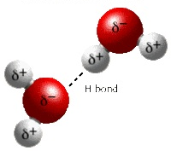
Parts of the energy
1st-order electrostatics | Coulomb interaction of unperturbed charge distributions of monomers | 2-body
Polarisation | 2nd-order electrostatics (NB: not just dipolar polarisability) | Many-body
Exchange-overlap | Pauli repulsion of closed shells | Mainly 2-body
Dispersion | Non-local electron correlation | Mainly 2-body
Monomer deformation | Bond stretch, bond-angle bend | 1-body
Charge transfer | Partial covalency | Mainly 2-body
The many-body expansion:
Xantheas et al…

Slide 7
QMC and quantum chemistry
Quantum Monte Carlo (CASINO code)
Variational Monte Carlo and Diffusion Monte Carlo (VMC & DMC)
VMC is standard variational principle, with energy expectation value evaluated by Metropolis sampling. Trial wavefunction: Slater determinant multiplied by Jastrow (correlation) factor.
Diffusion Monte Carlo: Evolution in imaginary time goes to (in principle exact) ground state. Uses similarity of TDSE to diffusion equation. Many-electron wavefunction treated as “density” of diffusing walkers. In practice: fixed-node approximation.
Quantum chemistry (Molpro code)
Hartree-Fock: best ground state without correlation
2nd-order Møller-Plesset: 2nd-order Rayleigh-Schrödinger perturbation theory (good approx. for water)
Coupled-cluster hierarchy: CCSD (coupled cluster singles and doubles) is related to Random-Phase Approximation.
CCSD(T) is the “gold standard” of wavefunction-based quantum chemistry. Accuracy: within 1 meV of exact for water dimer.

Slide 8
Quantum Monte Carlo
Basic ideas:
Propagation in imaginary time yields exact ground state:
so that:
Time-dependent Schroedinger equation is like diffusion eqn:
so represent as population of diffusing “walkers” with birth and death
Practical efficiency enormously improved by using “trial” wavefunction from variational Monte Carlo.
Fixed node problem: is an ampitude, rather than a density.

Slide 9
QMC on petascale computers
Advantages of QMC:
Easy to go to complete basis-set limit
Fairly mild scaling wrt system size O(N³)
Can be used either for isolated systems or in periodic boundary conditions
Ideally suited to massively parallel computers
Parallel scaling of CASINO code on JaguarPF (ORNL)

Slide 10
The water monomer
The deformation energy of the H₂O molecule as function of bond lengths and bond angle is known essentially exactly from quantum chemistry
Some DFTs (e.g. PBE, BLYP) give a very poor description, but DMC is very good
QMC for a range of water clusters: MJG, Manby, Towler, Alfè, J. Chem Phys. (2012)
Error in approximate deformation energy vs benchmark

Slide 11
The water dimer: DMC
Errors of total energy of H₂O dimer for thermal sample of 198 configurations drawn from AMOEBA m.d. simulation of liquid
Comparison of DFT errors with DMC errors. (“Errors” = deviation from CCSD(T) at CBS limit.)

Slide 12
Water dimer: correcting DFT for 1-body errors
1-body energy is sum of all monomer distortion energies
Some DFTs make serious errors in 1-body energy, but …..
We know H₂O distortion energy almost exactly (Partridge-Schwenke), so.…
It is easy to correct for 1-body error (just add difference between Partridge-Schwenke and DFT)
Remaining DFT errors after correction for 1-body errors

Slide 13
The water dimer: GAP
Correcting DFT with GAP (Csányi et al.)
Based on ideas of Bayesian learning from large databases of energies and forces of system of atoms and molecules: see Bartók, Payne, Kondor, Csányi, PRL (2010)
For H₂O dimer: 12 degrees of freedom: descriptor space consists of intra- and inter-molecular distances (symmetry is important).
First GAP for difference between DFT and MP2/AVTZ, second GAP for basis-set corrections and CCSD(T)-MP2.
Resulting DFT+GAP gives quasi-exact to within rms of ~ 1 meV.

Slide 14
GAP potentials: more details
We want to represent 2-body (dimer) energy
It’s a function of 12 degrees of freedom (6 internal, 1 distance, 5 orientational)
Theory of Gaussian processes for Bayesian machine learning
We want to predict energy E(x) at position x in 12-dimensional space given benchmark energies E(x_{i}) and gradients F(x_{i}) at a large number of points x_{i} in the space (typically a few thousand points gives an accuracy of ~0.1 mHa (2.5 meV) for the H2O dimer)
GAP principle can also be used to represent many-body interactions

Slide 15
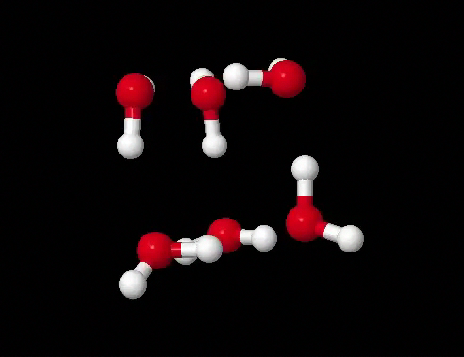
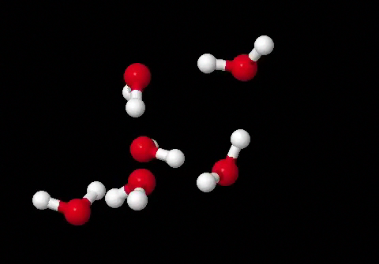
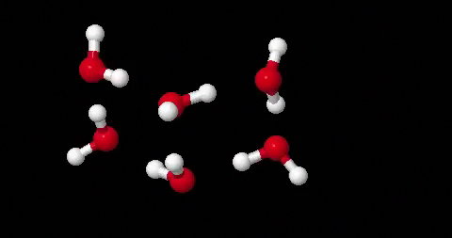
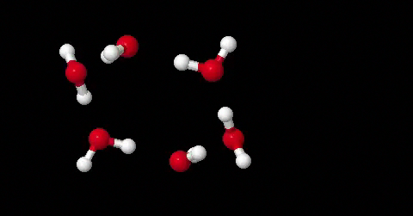
The water hexamer: four isomers
prism
cage
book
ring

Slide 16
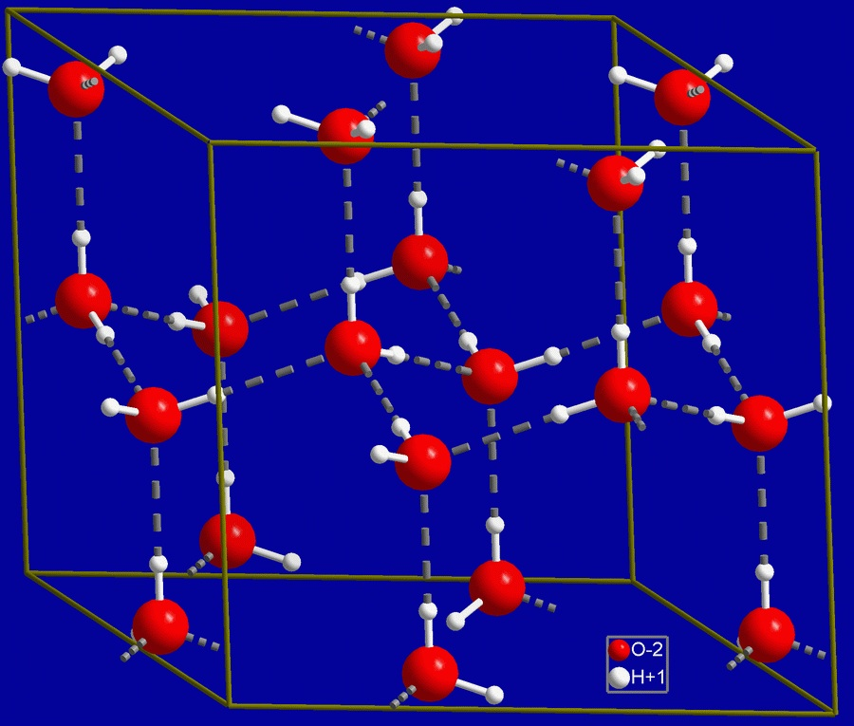
The structure of common everyday ice
Normal ice (ice Ih) has a hexagonal structure, with each water molecule donating hydrogen bonds to two neighbours and accepting hydrogen bonds from two other neighbours

Slide 17
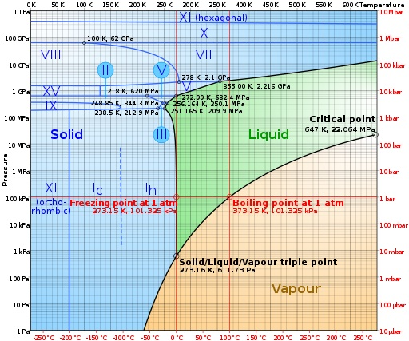
The phase diagram of water

Slide 18
DFT and QMC for ice structures
Relative energies
Volumes
Transition pressures
 | Ih | II | VIII
Expt | -610 | -609 | -577
DMC | -605 | -609 | -575
PBE | -636 | -567 | -459
PBE0 | -598 | -543 | -450
PBE0+vdW | -672 | -666 | -596
Santra et al. PRL (2011)
Cohesive energies of ice Ih, II and VIII (meV/H₂O)

Slide 19
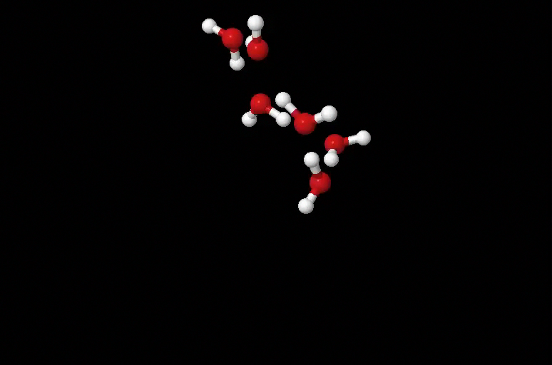
Hexamer in thermal equilibrium
M.d. simulation with Fanourgakis-Xantheas TTM3-F classical potential (flexible polarisable): T = 200 K, duration = 1 ns, configurations taken every 10 ps.
Key points:
BLYP-1 seriously underbinds
Underbinding decreases as cluster expands, so BLYP-1 errors make cluster expand in thermal equilibrium
GAP 2-body correction gives BLYP-2: slight overbinding, must be due to beyond-2-body
BLYP-2 errors almost config-indep, so may not affect thermal-eqm structure or dynamics.
Errors of BLYP (using DMC as benchmarks)
Red points: BLYP corrected for 1-body errors
Green points: BLYP corrected for 1-body and 2-body

Slide 20
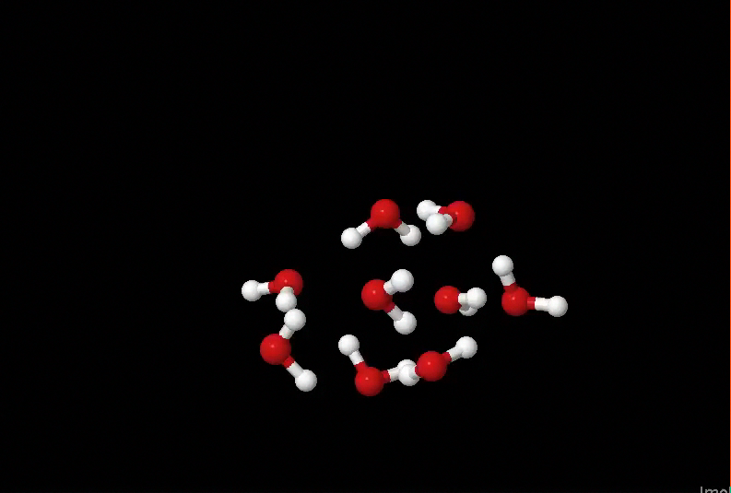
The nonamer in thermal equilibrium
M.d. simulation with Fanourgakis-Xantheas classical potential (flexible polarisable): T = 200 K, duration = 1 ns, configurations taken every 10 ps.
Similar to hexamer:
BLYP-1 greatly underbinds, makes cluster expand
BLYP-2 = BLYP-1 + GAP somewhat overbinds, because of beyond-2-body errors
BLYP-2 errors almost indep of config, so maybe ok for thermal eq structure and dynamics
Errors of BLYP (using DMC as benchmarks)
Red and blue: BLYP corrected for 1-body
Green and magenta: BLYP corrected for 1- and 2-body

Slide 21
Pentadecamer (15mer) in thermal equilibrium
100 configs from TTM3-F simulation at 200 K
Similar to hexamer and nonamer:
BLYP-1 greatly underbinds, makes cluster expand
BLYP-2 = BLYP-1 + GAP somewhat overbinds, because of beyond-2-body errors
BLYP-2 errors almost indep of config, so maybe for thermal eq structure and dynamics
Errors of BLYP (using DMC as benchmarks)
Red and blue: BLYP corrected for 1-body
Green and magenta: BLYP corrected for 1- and 2-body

Slide 22
Ice energetics with GAP
Preliminary results with GAP-corrected BLYP for energies of ice structures relative to ice Ih (meV/H₂O)
 | II | VIII | IX
Expt | 1 | 33 | 3
DMC | -4 | 30 | ?
BLYP+GAP | -5 | 30 | -3
PBE | 69 | 177 | ?
PBE0 | 55 | 148 | ?
Even though BLYP+GAP overbinds our thermal-equilibrium water clusters, it gives remarkably accurate values for relative energies of ice structures.

Slide 23
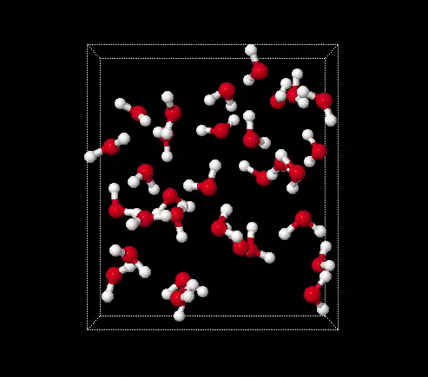
Statistical benchmarking of liquid water with QMC
Our work on clusters shows that DMC benchmarks for thermal samples of configurations can be used with GAP to analyse and correct 1-body, 2-body, beyond-2-body errors of DFT
We call this “statistical benchmarking”
Can we do DMC “statistical benchmarking” for liquid water?
Yes! We are already doing it. Tests show feasibility of DMC with good enough statistical accuracy on tens of configurations of 64-molecule periodic liquid water. (Of course, the configurations are generated with another techniques, e.g. corrected or uncorrected DFT.)

Slide 24
Where are the errors in DFT functionals?
There is no single answer – it depends on the DFT
For BLYP, dominant errors are in 1-body and 2-body; beyond-2-body error is not negligible, but it depends only weakly on configuration. So using GAP to correct 1- and 2-body gives big improvement.
For PBE, dominant errors appear to be in 1-body and beyond-2-body. So using GAP to correct 2-body is unlikely to achieve much – we will test this expectation.

Slide 25

Where so far? – Where next?
We want to achieve overall description: clusters, crystal, liquid
QMC succeeds where DFT fails
Water: the subtle balance between 2-body and beyond-2-body is crucial
Normal DFT fails, DFT+GAP is accurate for relative energies of clusters and crystal with judicious choice of DFT…
…but we need understand BLYP+GAP overbinding
The concept of “statistical benchmarking”: QMC for large thermal samples used to test and calibrate other methods
Will generalise to many other molecular systems: CH₄, NH₃, HF, H₂O + CH₄ , H₂O + HF ⥨ H₃O⁺ + F⁻ , …
Project made possible by large allocation of time on JaguarPF under Incite program

